Slide 1

UNIVERSITY INSTITUTE OF SCIENCES
Academic Unit V
Bachelor of Engineering
(Computer Science & Engineering)
Biology For Engineers
23SZT-148
Sensors/ receptors in the human body
Chemoreceptor: hot and cold receptors, sensors for smell, sound, vision
DISCOVER . LEARN . EMPOWER

Slide 2
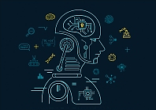

Course Outcome
CO Number | Title | Level
CO1 | Identify the biological concepts from an engineering perspective. | Remember
CO2 | Development of artificial systems mimicking human action. | Understand
CO3 | Explain the basic of genetics that helps to identify and formulate problems | Understand
CO4 | Apply knowledge of measurement system, biomedical recording system and biosensors to excel in areas such as entrepreneurship, medicine, government, and education. | Understand
CO5 | Integrate biological principles for developing next generation technologies
Will be covered in this lecture
https://images.app.goo.gl/5obqqxo93P2UBmdU6

Slide 3
SYLLABUS
Unit-2 | Biosensors and measurement system | Contact Hours: 15
Chapter 1 Medical Instrumentation Chapter 2 Measurement System Chapter 3 Biological Sensor | Medical Instrumentation: Sources of biomedical Signals, Basic medical Instrumentation system, Performance requirements of medical Instrumentation System, Microprocessors in Medical instruments, PC base medical Instruments, General constraints in the design of medical Instrumentation system, Regulation of Medical Devices. Measurement System: Specification of instruments, Statics & Dynamic characteristics of medical instruments, Classification of errors. Statistical analysis, Reliability, Accuracy, Fidelity, Speed of responses, Linearization of technique, and Data Acquisition System. Biological sensors: Sensors/ receptors in the human body, basic organization of the nervous system- neural mechanism, Chemoreceptor: hot and cold receptors, sensors for smell, sound, vision, Ion exchange membrane electrodes, enzyme, glucose sensors, immunosensors, & biosensors & applications of biosensors.

Slide 4
Biological Sensors
Sensors/ receptors in the human body
Chemoreceptor: sensors for smell and taste
Photoreceptor: vision
Mechanoreceptor: hot and cold receptors, sound

Slide 5
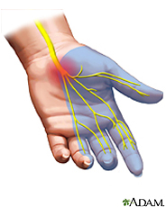
What is a sensor?
A sensor is a device that measures a physical quantity.
Example: When you touch an object, sensors on your fingers send signals to your brain so that it measures temperature, and so your brain recognizes the object as being hot or cold.
The skin in your fingers contains millions of sensitive nerve endings that can detect temperature.
Notes:
Sensing is all about measuring physical quantities and interpreting these measurements in order to draw conclusions.

Slide 6
What are Receptors?
Convert energy from both external and internal environments into electrical impulses (signal by neuron).
Biological transducers
Energy
Electrical impulses

Slide 7
What is a transducer?
A transducer is a device that converts one signal to another.
Examples: A car speedometer converts wheel rotation to a speed reading. These signals are sent to the computer/display.
One signal
Other signal

Slide 8
What are sensory receptors?
Specialized structures- respond to the changes (stimuli) in the environment.
Sensation and interpretation takes place in brain.
Keep aware our internal body and external environment.
The human body can achieve an understanding of the world through its Sensory/Receptor systems.

Slide 9
How Sensory Receptor systems works?
stimulus > sensor > coordinator > effector > response
touch > pain receptor > nervous system > muscle > movement
The sequence of steps above describes what happens when you touch something hot—the stimulus is touch, the sensor is the temperature receptor on your finger that senses it and relays it to the nervous system (spinal cord and brain), which is the coordinator.
The coordinator makes the decision of how to react, and then commands the hand muscles (the effector) to jerk back quickly.
In summary: We go from stimulus (touch) to response (movement of hand).
Notes:
Sensing is all about measuring physical quantities and interpreting these measurements in order to draw conclusions.

Slide 10
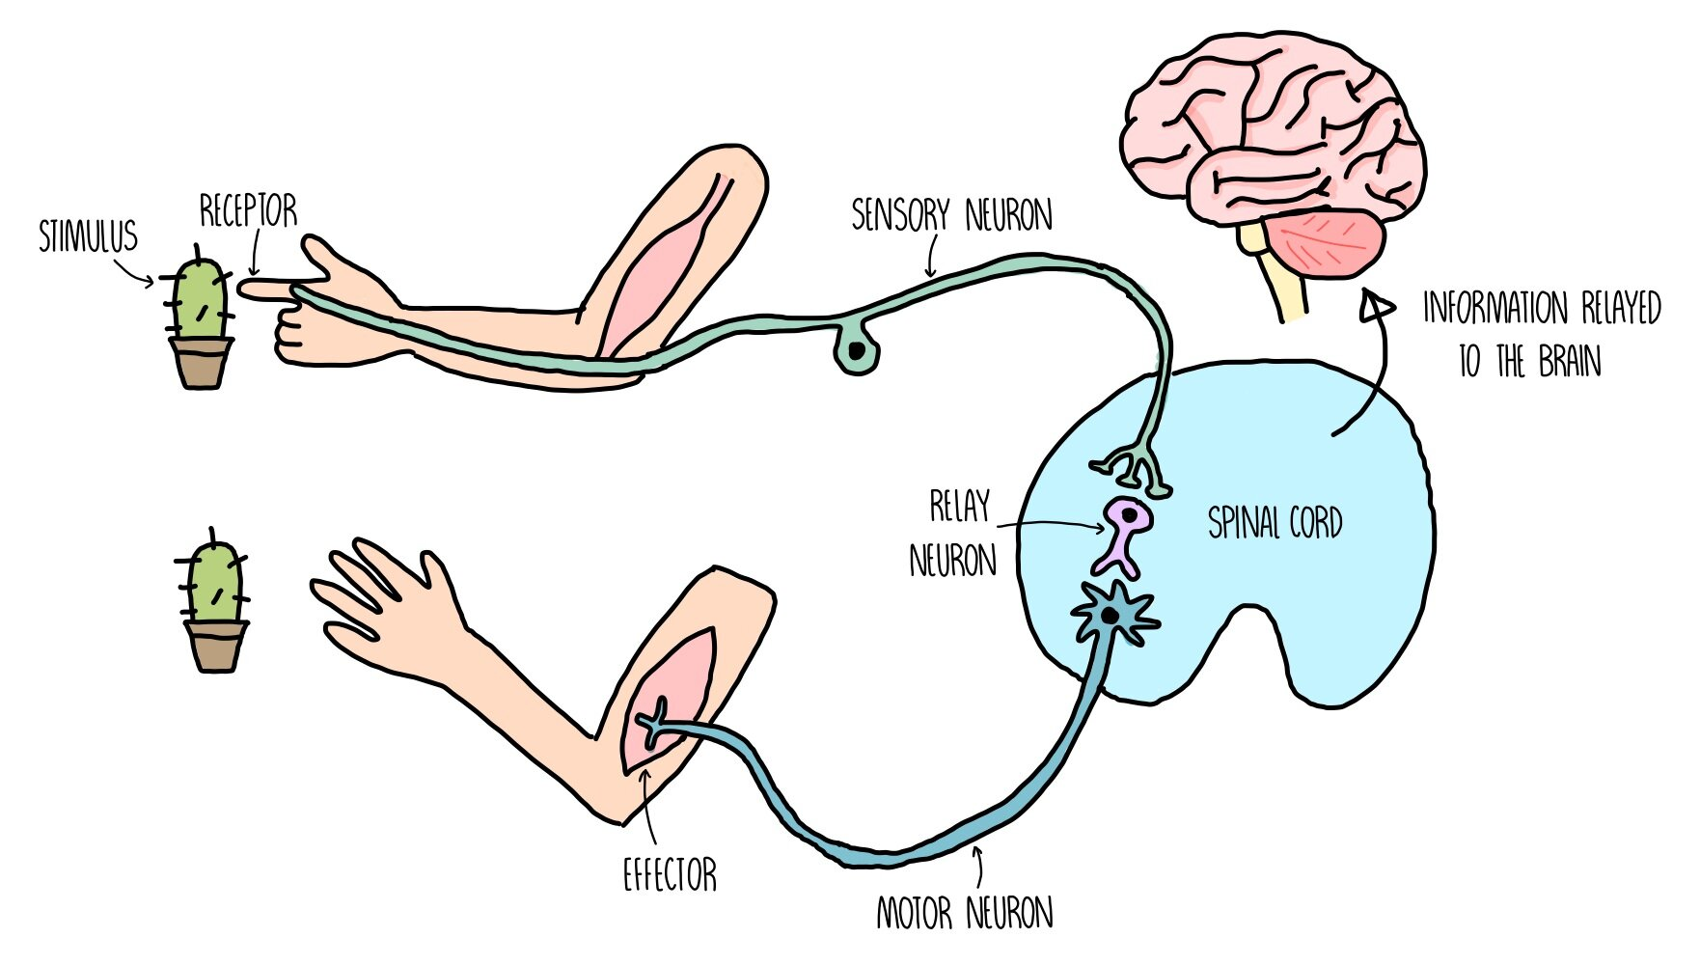

Slide 11
Sensation
Sensation refers to our ability to detect or sense the physical qualities of our environment.
Sensation is to awareness, as perception is to interpretation.

Slide 12
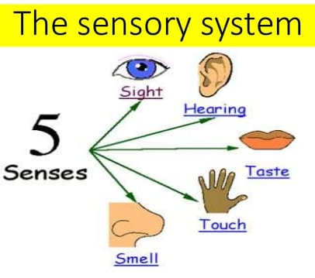
Human Sensors
Your sensory organs (eyes, ears, nose and skin) provide information to your brain so that it can make decisions.
Similar to the working of robot sensors.
Your brain continuously uses the information that it receives from your sensory organs to make your body function.
Five main human senses:
Your eyes allow you to see the world
Your ears allow you to hear sounds
Your skin lets you feel objects through touch
Your nose lets you smell the many scents in the world
Your tongue lets you taste

Slide 13
Types of Environmental Stimuli/ Sensors and receptors of human body
Chemoreception
Photoreception
Mechanoreception

Slide 14
Chemoreception
Detection of chemical types and concentrations
Receptors for chemoreception are called Chemoreceptors (CHEMOSENSORS- is a specialized sensory receptor cell which transduces a chemical substance to generate a biological signal.).
Types of chemoreceptors:
1. Taste Receptors
– Detects chemicals dissolved in water within the mouth
2. Smell- Olfactory Receptors
– Sense chemicals in the air
3. Osmoreceptors
– Detect change in osmotic pressure.

Slide 15
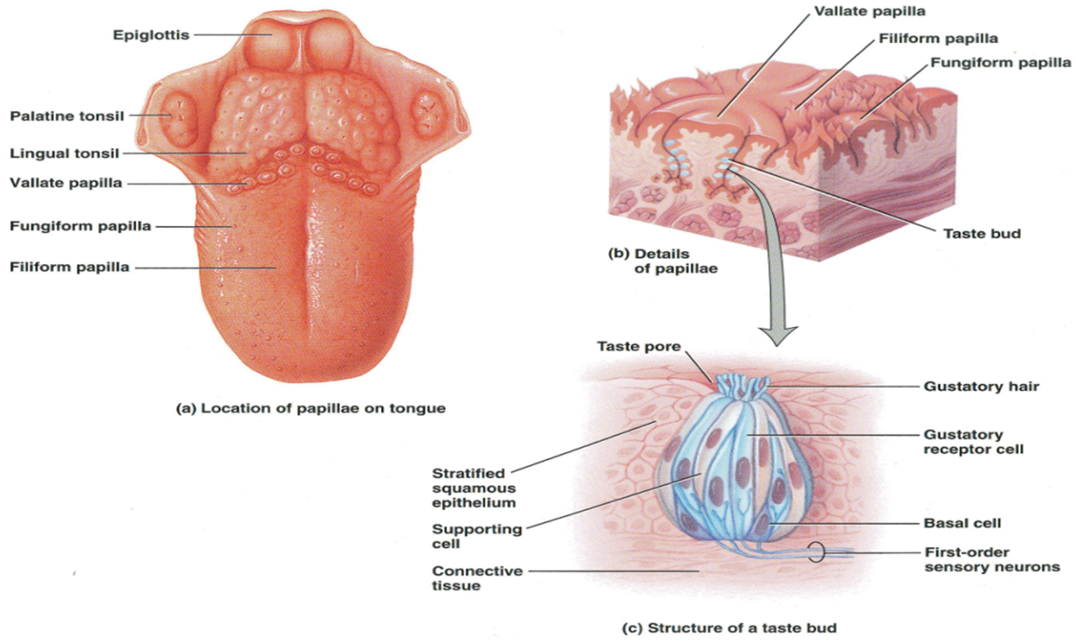
Taste Receptors (Taste Buds)
GUSTATION: SENSE OF TASTE
Allows to detect and identify dissolved chemicals
Chemicals known as tastants
Pits found on upper surface of the tongue consist of sensory cells (taste buds)
Every sensory/receptor cell has a tiny hair called a gustatory hair/microvilli, that project into the saliva

Slide 16
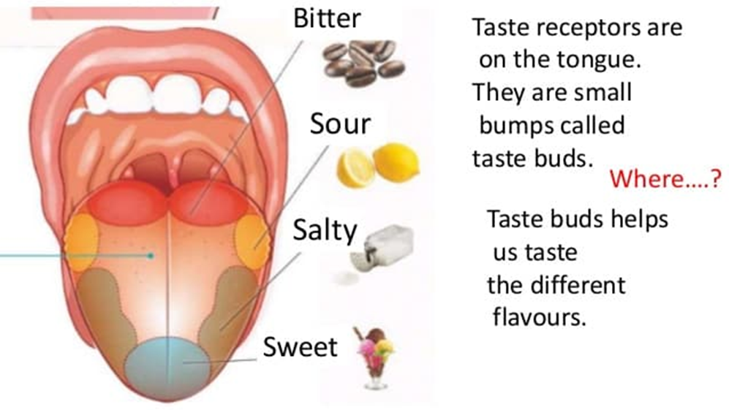
Taste: How do we taste using our tongues?
The tongue has sensory receptors called taste buds present all over the tongue, which can detect 5 different flavors: sweet, salty, bitter, sour, umami (meaty)
Umami

Slide 17
Taste Buds: Respond to any one of five primary tastes: sweet, sour, bitter, salty, or umami
Sensory Nerves: send messages along to the brain
Food Particles: Chemicals come into contact with the gustatory hair receptors
Flavors are then interpreted by brain

Slide 18
Olfactory Receptors (SMELL)
The organ of smell is the olfactory organ
Detects/Responds chemicals in the air
Olfactory receptors are located in the nose
Consists of nerve cells that have tiny hairs on the surface
Stimulated by odorants; inhaled chemicals
Signals are transferred to the first-order neuron of olfactory pathway
Odorants
Olfactory receptors respond to molecules
Impulse fired and sent to the brain for interpretation

Slide 19
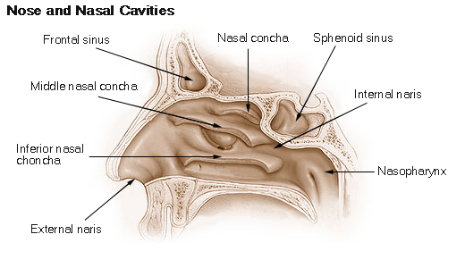
Smell: How do we smell using our noses?
Small particles of almost everything around us can be found in the air.
These particles enter the nose when you breathe in and contact nerve endings in the upper nasal passage.
The nerve endings send signals through the nervous system to the brain, which identifies the smell.
Humans can distinguish between hundreds of different smells.
Dogs can distinguish between thousands.

Slide 20
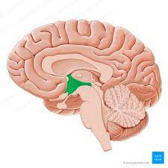
Osmoreceptors Detect change in osmotic pressure.
Located in the hypothalamus are capable of sensing the concentrations of solutes, particularly sodium ion.
Monitor the levels of carbon dioxide and oxygen by detecting changes in the pH levels of the cerebral spinal fluid.
If, for example, your oxygen levels are too low, your osmoreceptors convey a message that triggers an increase in respiration.

Slide 21
Photoreception (VISION)
Mechanism of light detection.
Reception of visual signals
Light enters the eye >>> Photoreceptors cells stimulated (specialized cells)
Three layers: Photoreceptor layer, bipolar cell layer, and ganglion cell layer
Two types of cells in photoreceptor layer:
Rods (allow us to see shades of gray in dim light, like moonlight)
Cones (stimulated by brighter light- highly acute, color vision)

Slide 22
Vision: How does the brain understand what we see?
Light (stimulus) from the object enters the eye.
Light sensors convert (transduce) light into an electrical signal.
This electrical signal passes through the optic nerve, which relays the information to the visual cortex.
The visual cortex processes this information and “recognizes” the object seen.
Cones and rods send signals through the optic nerve to the brain.
Millions of rods and cones are present in each of your eyes, and they send their signals to the visual cortex of your brain.
Rods cannot distinguish colors, but are responsible for low-light black-and-white vision.
Cones are responsible for color vision.

Slide 23
Mechanoreception
Mechanoreceptors
Ability to detect and respond to certain kinds of stimuli—notably touch, sound, and changes in pressure or posture—in its environment.
Detection of Mechanical Energy and Force
– Tactile (touch and pressure)
– Vibrations (sound)

Slide 24


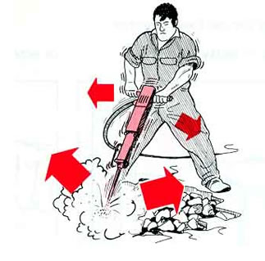
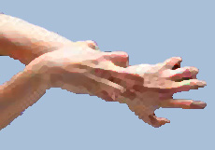
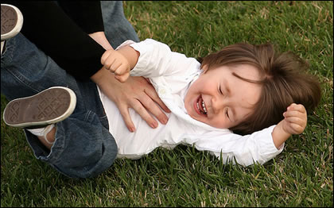
Tactile (Touch)
Touch is an important sense because it provides important information about:
Proximity of food
Predators
Environmental features
Tactile Sensations (Mechanoreceptors)
Touch, pressure, vibration
Itch and tickle
Detected by nerve endings

Slide 25
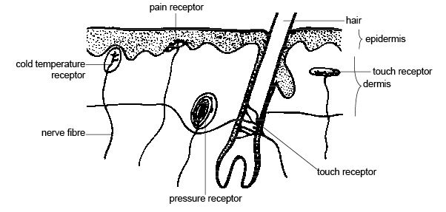
General senses in the skin
Pain Receptor
Cold Temperature Receptor
Touch Receptor
Touch Receptor
Pressure Receptor

Slide 26
Baroreceptors- monitor blood pressure
Baroreceptors are specialized mechanoreceptors in the walls of blood vessels, to sense pressure
These are located on both arteries and veins.
Blood pressure is constantly monitored by baroreceptors, as they detect changes in your blood pressure.
They communicate to the brain whether blood pressure is too low or high, so that the brain can adjust the blood flow accordingly.

Slide 27
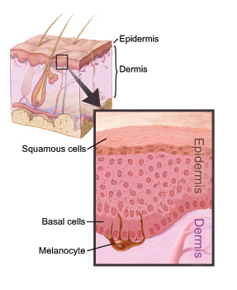
Thermoreceptors (Thermal Sensations )
Thermoreceptors: free nerve endings
Thermal sensations: coldness and warmth
Temperatures between 10° and 40°C (50-105°F)
activate cold receptors
located in the epidermis
Temperatures between 32° and 48°C (90- 118°F)
activate warm receptors
located in the dermis
Below 10°C and above 48°C stimulate
Nociceptors
produce painful sensations
Located in skin, muscles

Slide 28
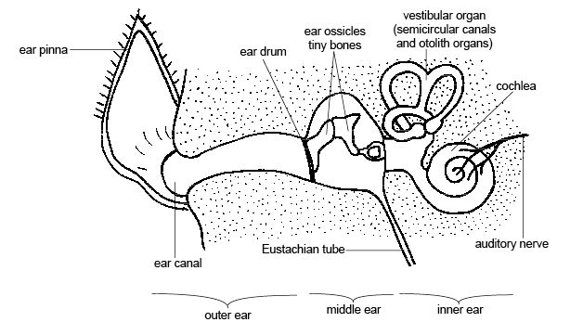
Vibration (SOUND)
Stimulates hair cells which triggers electrical impulses to the brain.

Slide 29
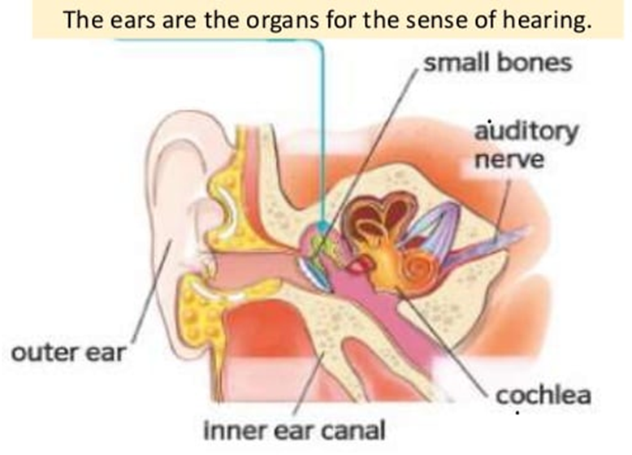
Sound: How do your ears work?
First the outer ear collects the sound waves then the sound enter the ear canal and cause the eardrum to vibrate.
Cochlea to vibrate.
When cochlear fluid vibrates, it moves hairs connected to nerve cells, which send signals to the brain through the auditory nerve.
The brain helps you recognize the sound.
Sound: How many sensors do our ears have?
Thousands of neurons in your ears respond to sound.
These neurons respond differently to different pitches.
Pitches range from low (such as from drums) to high (such as from bells).
Notes:
The hammer, anvil, and stirrup are the smallest bones found in the human body. They also can be called by their latin names: the malleus, incus, and stapes, respectively. Collectively they are called ossicles.
The cochlea is the part of the inner ear involved in hearing. It is a spiral-shaped cavity in the bony labyrinth, in humans making 2.75 turns around its axis, the modiolus. ... The name cochlea derives from Ancient Greek κοχλίας (kokhlias) 'spiral, snail shell'.

Slide 30
Passage of Sound through the Ear

Slide 31
REFERENCES
C.B. Powar, 2010.Cell Biology. 5th Ed, Himalyan Publishing House.
Jeremy M. Berg, John L. Tymoczko and Lubert Stryer. 2006. “Biochemistry,” 6th Ed. W.H. Freeman and Co. Ltd.
Robert Weaver. 2012 “Molecular Biology,” 5th Edition, MCGraw-Hill.
Jon Cooper, , 2004. “Biosensors A Practical Approach” Bellwether Books.
Martin Alexander, 1994 “Biodegradation and Bioremediation,” Academic Press.
D. Albe-Fessard et. al. Handbook of Sensory Physiology. DOI: 10.1007/978-3-642-65438-1; ISBN: 978-3-642-65440-4
https://www.ncbi.nlm.nih.gov/books/NBK547656/

Slide 32
THANK YOU

